Slide 1
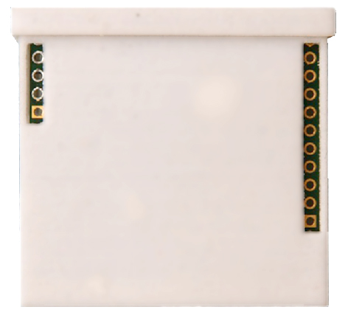
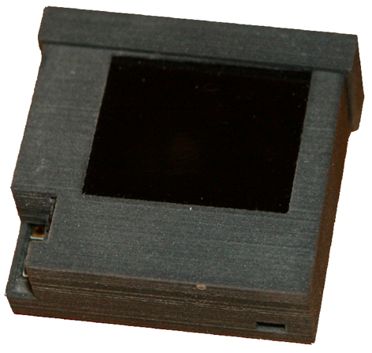
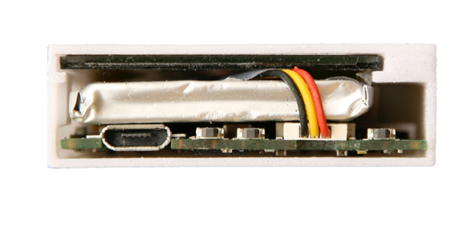
Anatomy of LimiFrog
BACK
STM32 Program /
Debug interface
(SWD)
Removable lid
(Not exposed here)
BlueTooth module
SWD interface
(optional use)
OLED Display
Extension port
(configurable digital/analog interfaces)
TOP (Lid Removed)
Case opening for
ambient light sensor /
proximity detector
Micro-USB plug
(receptacle)
Slot for sound to
microphone
2 general-purpose switches
(mini push-button)
ON/OFF switch
(mini push-button)

